Slide 1
Observables
ReactiveX, RxJS
Observer, Subject
Generics

Slide 2
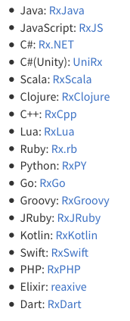
ReactiveX
ReactiveX has become a standard way of implementing observables in different programming languages
ReactiveX supports many popular languages:
Angular uses RxJS
(Reactive Extensions for JavaScript)

Slide 3
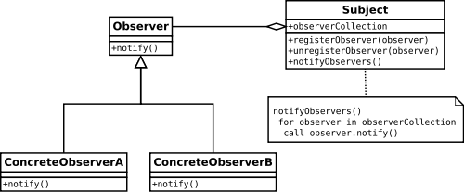
Subject
In the previous set of slides we had a class called Subject which was the source of events sent to Observers
This is based on the Gang of Four Observer pattern:
Notes:
the subject can have observers subscribe and unsubscribe as well as notify them of changes to the data,

Slide 4
RxJS Subject, Observable, and Observer
RxJS also defines a class for Subject and an interface for Observer
In addition it also defines a class for Observable

Slide 5
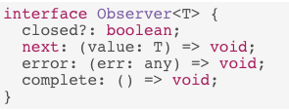
Observer interface
This is the code for the RxJS Observer interface:
Do you understand this?
RxJS is using a more modern way of expressing functions which we will cover now….
Notes:
interface is using generic typing and arrow function syntax.

Slide 6
Generics

Slide 7
Generics
Generics allow us to define a generic type for a function and use that type consistently throughout the function
Here is the every function with generics:
The number type has been replaced with T, note that <T> occurs after the function name, effectively declaring that type for the function
function every<T>(array: Array<T>, fn: (x: T) => T): void {
for (let i = 0; i < array.length; i++) {
array[i] = fn(array[i]);
}
}

Slide 8
Observer interface

Slide 9
Functions as a type
We now can decipher the Observer interface more clearly
next is a variable that can store a function which takes a parameter of type T and doesn't return anything
next, error, and complete are callback functions, they will be called by the subject
In our original implementation of Observer we just had the changed function

Slide 10
next, error, complete
The next function is called by the subject every time a new event occurs, it is equivalent to the changed method from the previous slides
The error function will be called if an error occurs in the subject
The complete function will be called once the subject has finished and won't emit anymore events
In some scenarios you may only use the next function

Slide 11
Creating an observer
Here is an example of an Observer, it will listen for new numbers:
class NumberObserver implements Observer<number> {
next(value: number): void {
console.log("Next number: " + value);
}
error(err: any): void {
console.log("Error: " + err);
}
complete(): void {
console.log("We are finished!");
}
}

Slide 12
Subject

Slide 13
Subject
The Subject class is a central part of RxJS and provides a lot methods
However the Subject class itself doesn't directly provide the methods
The Subject class is a subclass of the Observable class which provides all of the methods
What is the difference between Subject and Observable?
Subject manages its own list of observers
Observable doesn't manage the list of observers, a subclass will need to do it

Slide 14
Subject example
We can create a subject which emits numbers for our NumberObserver:
let observer = new NumberObserver();
let subject = new Subject<number>();
// Add observer to the list of observers
subject.subscribe(observer);
// Notify all observers of the following two numbers
subject.next(5);
subject.next(7);
// Remove observer from the list of observers
subject.unsubscribe(observer);

